Slide 1

WORK PATH
Employment for semi literates.
Helps you to earn.

Slide 2
TEAM – WEB WORLD
Koona Kavya
Katla Likhitha
Gundla Vilasini
Kashigari Gayathri
Duggireddy Sri Chandana reddy

Slide 3
INTRODUCTION
Our project is Work path. Our motto is to provide part/full time work for semi-literates. So that they can be independent. Through this website we can provide some jobs in different sectors.

Slide 4
WHY WORK PATH ?
Our theme is to come up with work for home makers and interested people who want to work in free time. So, that they can have side income or earn income. It is dream for many people to be independent. This website helps to achieve it.

Slide 5
OUR VISION
Our vision is to transform lives and communities by creating a platform that offers dignified work opportunities for semi-literate individuals, particularly homemakers who often face limitations in accessing employment outside their homes. We envision a world where every person can contribute to their family's well-being while maintaining a healthy work-life balance.
Work Path was born out of the desire to address the challenges faced by semi-literate individuals who possess valuable skills but lack opportunities to showcase them.

Slide 6
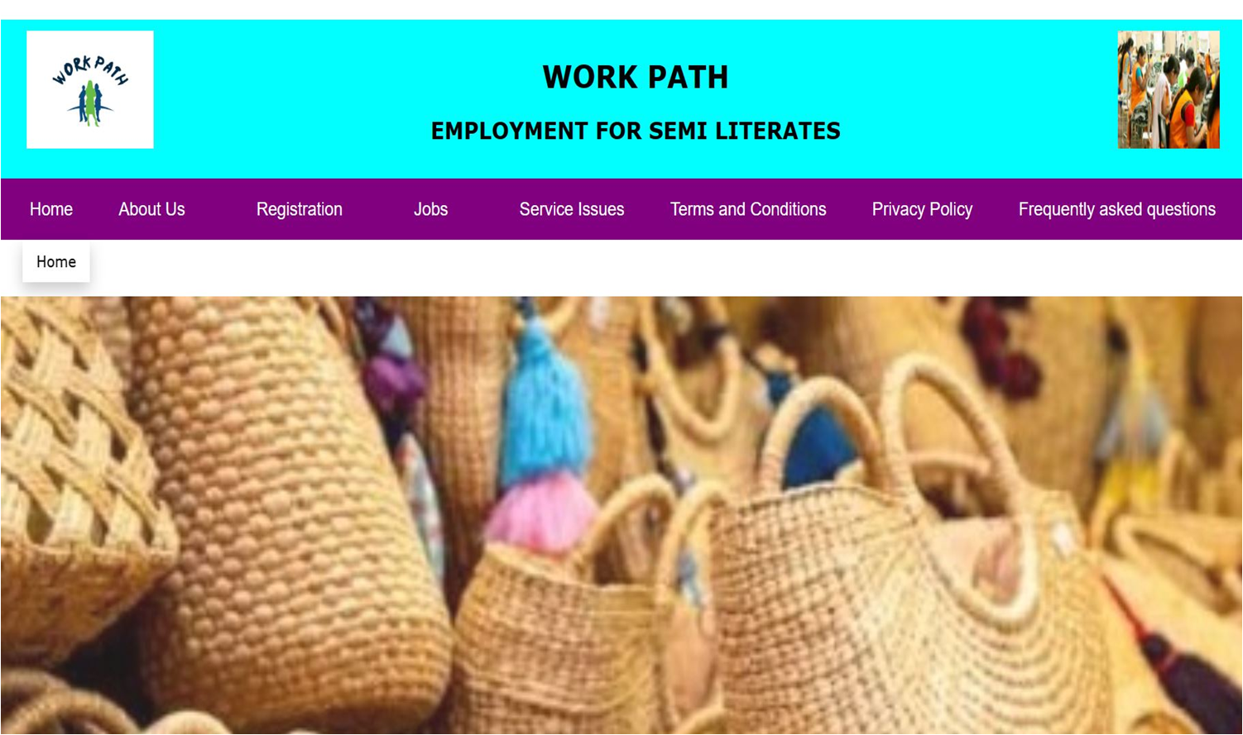
SITE MAP
MAIN PAGE
HOME
MAIN PAGE
ABOUT
ABOUT
REGISTRATION
SUBMITTED
JOBS
SERVICE
ISSUES
TERMS & CONDITIONS
PRIVACY POLICY
FREQUENT
QUESTIONS
SERVICE ISSUES
FREQUENT QUESTIONS
JUTE BAGS
CANDLE MAKING
PACKING
STITCHING
HOME FOODS
COTTON WICKS
SUBMITED
FREQUENT QUESTIONS
PRIVACY POLICY

Slide 7

technologies used
HTML
CSS
JAVASCRIPT
BOOTSTRAP

Slide 8
THANK YOU

